Slide 2
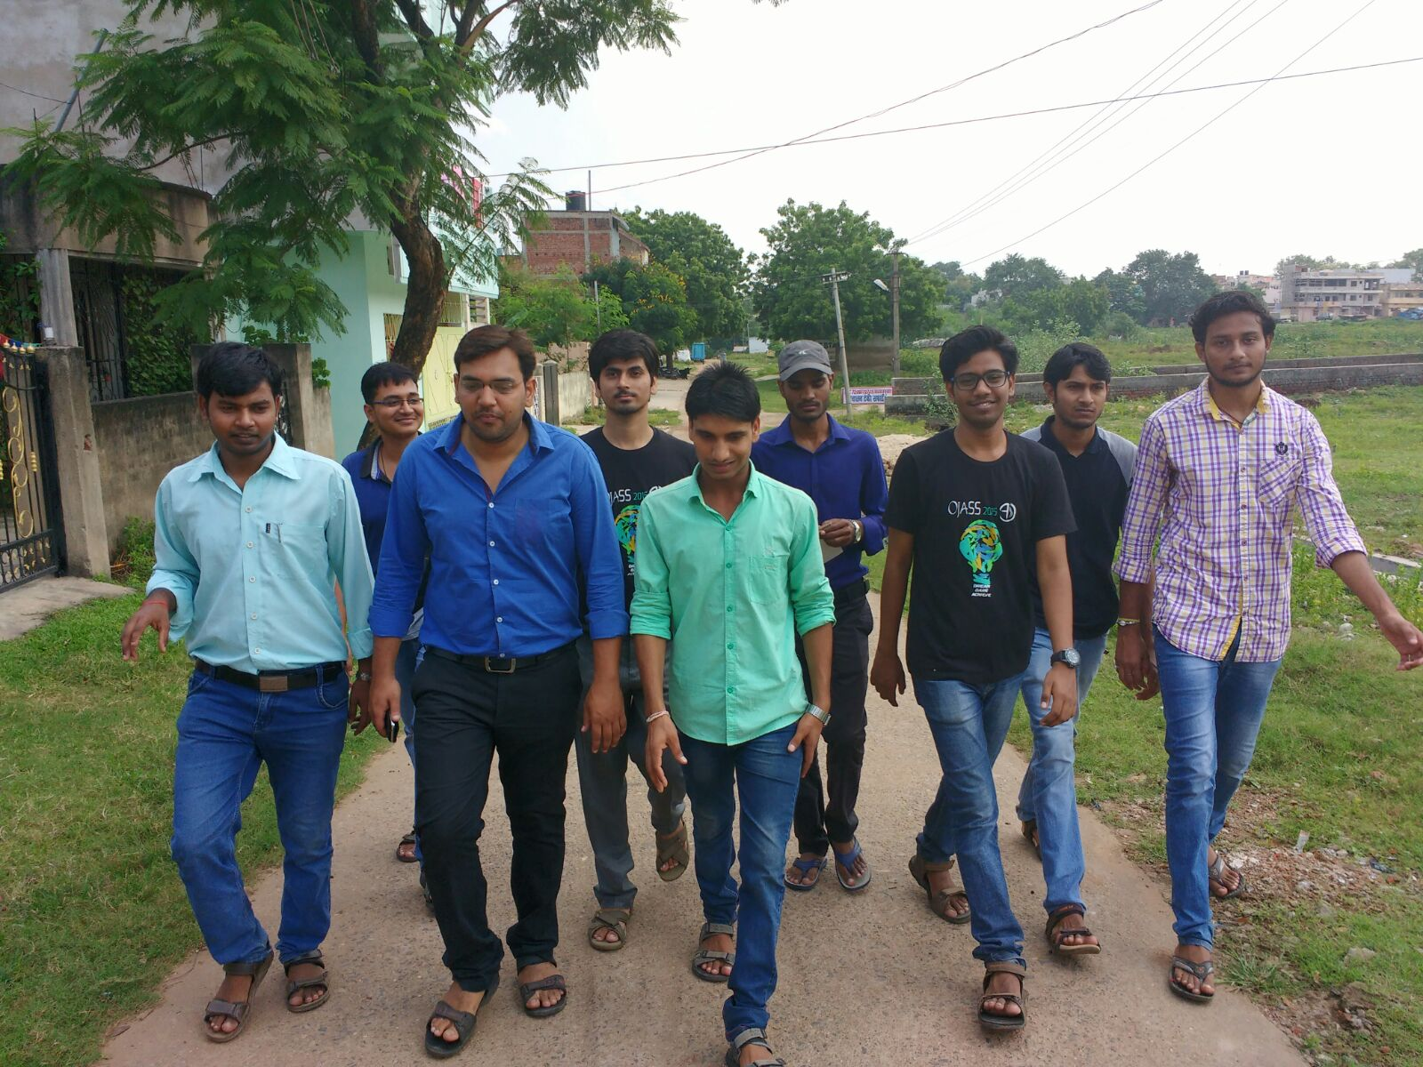
On your mark, get set , go !!!

Slide 3
VISION AND PLAN FOR THE CENTER
Sankalp Team surveyed few areas in Adityapur and identified Rickshaw Basti and Bantanagar as the most backwards blocks.
Sankalp will run tuition classes for students from class3-9th near Durga Mandap, MIG Colony
Special classes for selected bright students for Navodaya, Netarhat and Sainik School preparation

Slide 5
TO SCRIPT A GLORIOUS CHAPTER

Slide 6
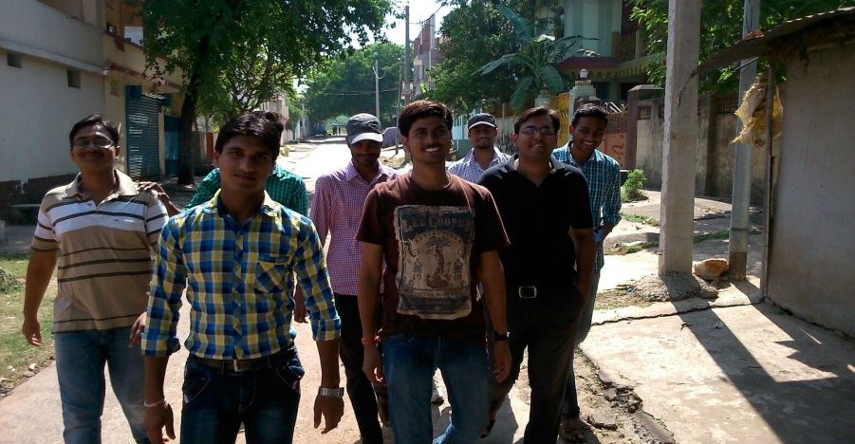
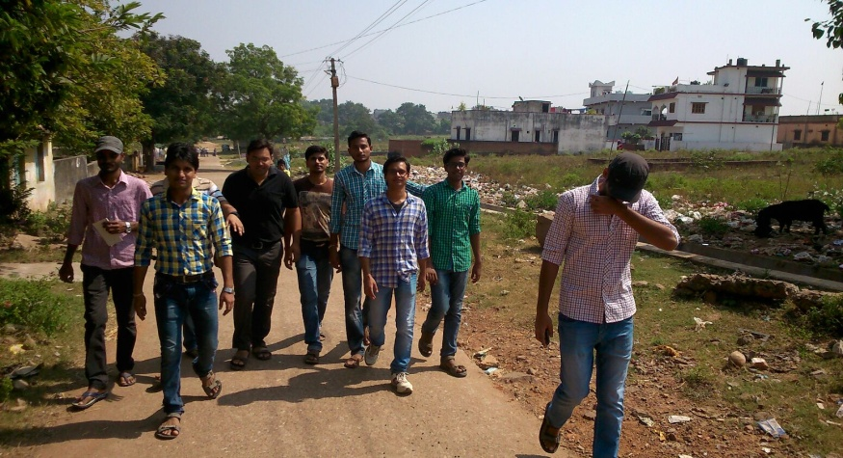
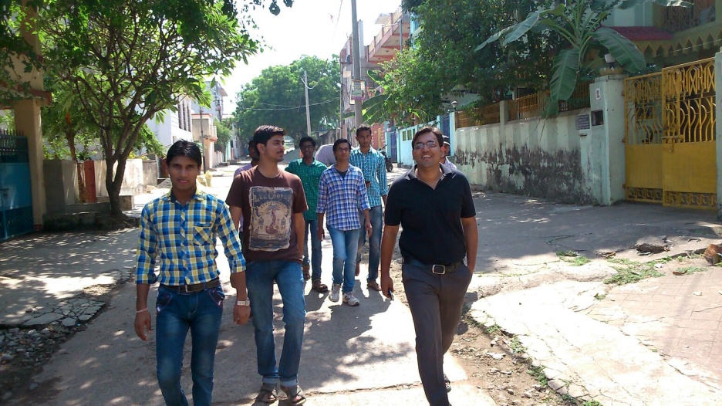
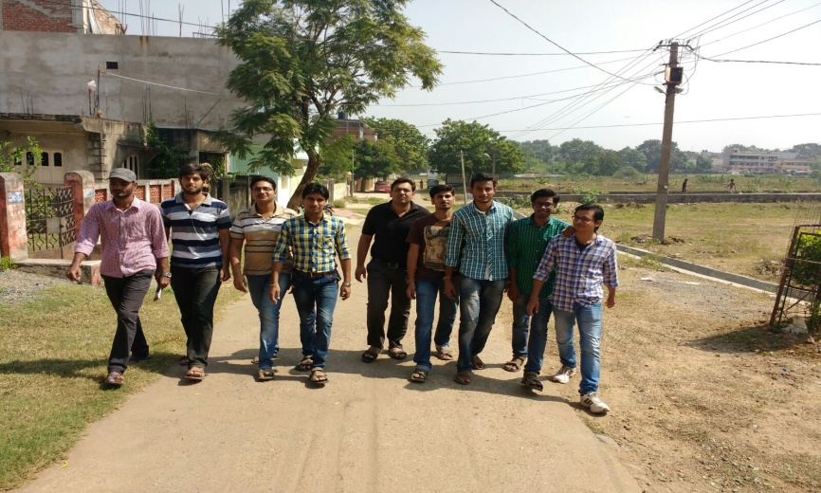
TO SERVE IS BEAUTIFUL, BUT ONLY IF IT IS DONE WITH JOY, WHOLE HEART AND A FREE MIND

Slide 8
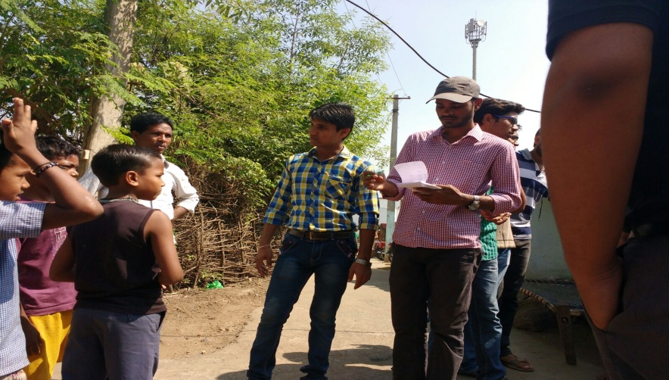
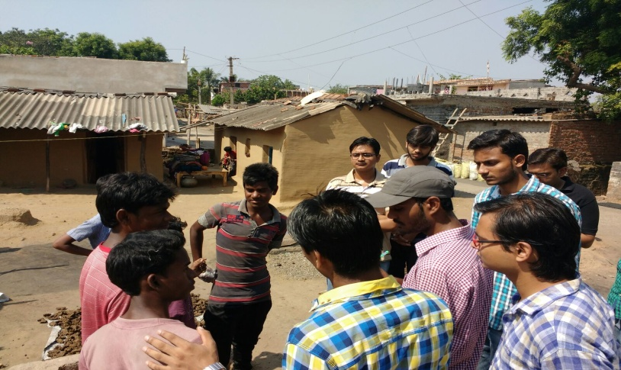
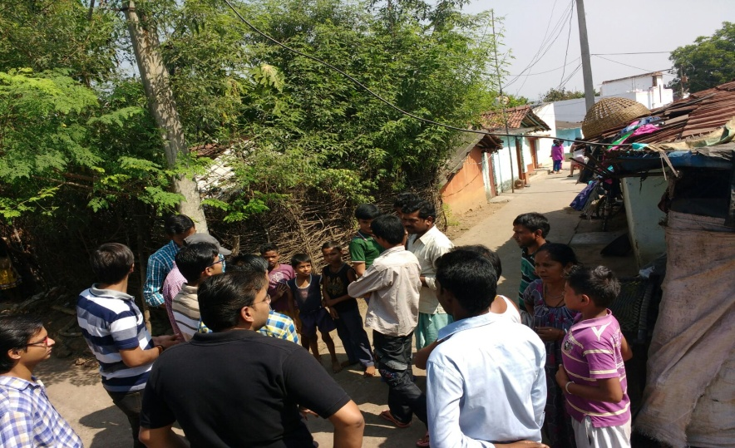
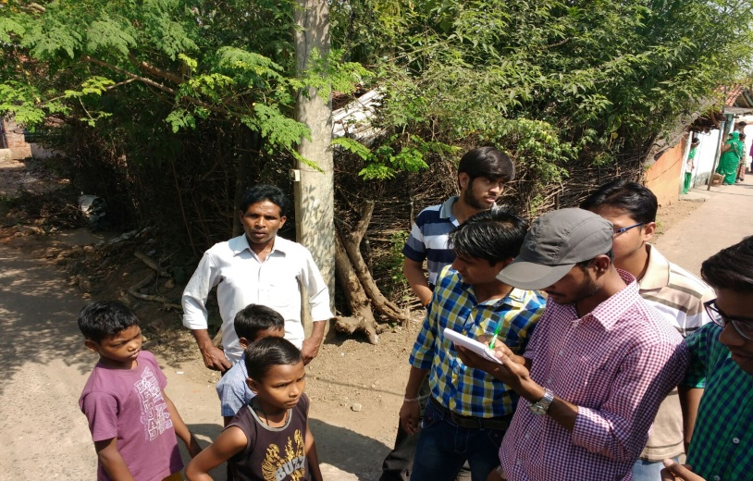
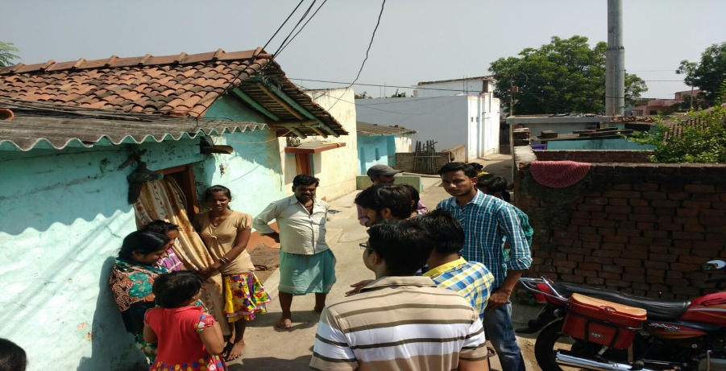
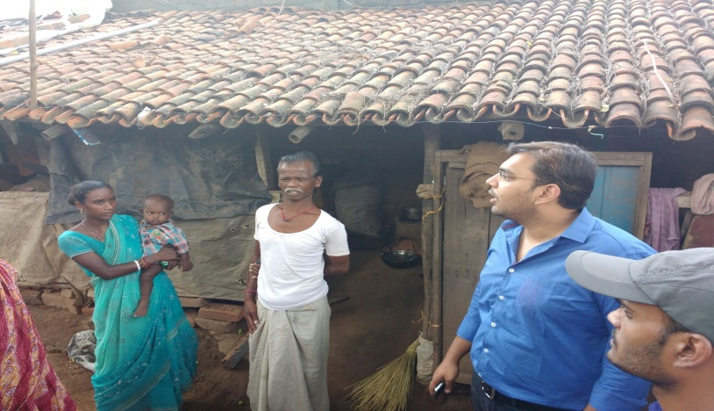

Slide 9
"Change will not come if we wait for some other person or some other time. We are the ones we've been waiting for. We are the change that we seek.“

Slide 10
COME BE A PART OF THE JOURNEY
You can donate at any our centres by just making a call to Sankalp-A Pledge to Change volunteers.
All our centres are Adityapur based and run 6 days a week
You may donate books from
Class 1-8- Course Text Books (Any Board)
Story Books
Unused stationery
Any other items like bag, toys, uniforms etc.
Relevant Contact Nos. Are
Subodh Kumar Das-9798756336
Mayank Aggarwal -9031975746
Suresh Pareek -7209632032
Vikas Dixit -9472706225

Slide 11
ACCOUNT DETAILS FOR SUPPORT
Sankalp Account Details
You can transfer funds online into our account:-
“SANKALP” A/C No.-31114719936
CIF No: 85757412911
IFSC Code: SBIN0001882
MICR Code: 831002004
Branch code: (1882)
Branch: SBI- RIT JAMSHEDPUR
You may also visit our website and pay through online link available over it.
www.sankalpnitjamshedpur.org

Slide 12
“You have not lived today until you have done something for someone who can never repay you.”
www.sankalpnitjamshedpur.org

